Slide 1
ATReference
Customizing Open Source Software
for the Archival Community
Marisa Hudspeth
Lead Archivist, Digital Program
Rockefeller Archive Center
SAA, August 2011

Slide 2
ATReference Development Team
Marisa Hudspeth, Project Manager Rockefeller Archive Center
Rebecca Robbins, Project and Documentation Coordinator Rockefeller Archive Center
Lee Mandell, Lead Programmer
Nathan Stevens, Programmer
Brian Stevens, Reports Designer & Testing Coordinator West Connecticut State University
Laura Montgomery, Interface and Usability Tester Rockefeller Archive Center
Sibyl Schaefer, Usability Consultant Rockefeller Archive Center

Slide 3
ATReference Genesis
To replace Re:discovery functionality for managing patron registration and duplication services
To consolidate similar/duplicate patron information captured, stored, and managed in multiple paper and electronic systems
To improve the efficiency, quality, and security of our researcher services by streamlining and automating data capture and manipulations for all aspects of our researcher services
To opt for open-source development instead of a proprietary solution in order to make a contribution to the archival community

Slide 4
Priority Breakdown
Priority 1: Patron Registration
Priority 2: Duplication Services
Priority 3: Retrievals, Bar-coding, and Use Tracking
Priority 4: Reference Requests and Reading Room Scheduling
Priority 5: Web Interface and Personalized User Accounts

Slide 5
Priority 1: Patron Registration
Expand AT Names Module to accommodate researcher registration information
Track research visits
Track funding awarded to researchers by the archive center
Track publications of researchers
Track completion of necessary researcher paperwork
Provide ability to search and manipulate data for statistics and reports

Slide 6
Priority 2: Duplication Services
Manage all types of duplication requests, including submitting request, distributing request to appropriate staff, and tracking paperwork
Create standardized invoices in PDF to be emailed or printed
Store fee schedules, flat shipping rates for domestic and international, automatically calculate cost estimates, and create invoices
Track duplication service requests, including copy counts per calendar year
Provide ability to search and manipulate data for statistics and reports

Slide 7
Priority 3: Retrievals, Bar-coding, and Use Tracking
Track use of materials by patrons
Provide ability to search and manipulate use data for statistics and reports
Automate “charge-out” procedure using bar-coding
Add barcode functionality to Accession records and folder and item levels of Resource records
Provide ability to electronically submit retrieval requests at the box, folder, and/or item level based on electronic and print finding aids

Slide 8
Priority 4: Reference Requests and Reading Room Scheduling
Electronically distribute reference requests to staff
Allow staff to respond to reference requests from within the AT
Store history of requests, staff assignments, and responses
For archives that require appointments in advance and/or limit the number of researchers per day, manage scheduling of research appointments, including flexibility to deal with special openings and closings due to holidays, weather, etc.

Slide 9
Priority 5: Web Interface and Personalized User Accounts
Enable a patron to create a personal user account to:
update their contact information at any time
submit reference requests via a web form
schedule and cancel reference appointments
specify transportation method and reserve seats on shuttle service
be notified of inclement weather closures and delayed openings (RSS feeds)
sign up for waiting lists on full days and automatic notification
sign up to receive email newsletters and announcements
directly submit retrieval requests online at the box, folder, and/or item level
view status and history of requests (retrievals, duplication, reference)
view an online orientation video and agree to terms
exchange electronic files with staff
use e-commerce features to pay for services
electronically sign and submit paperwork online
optionally share research topic and connect with other researchers

Slide 10
Target Timeline
Priority 1 – Released May 2011
Priority 2 – December 2011
Priority 3 – July 2012
Priority 4 & 5 – To be determined
For more information, Please visit our Github site:
https://github.com/RockefellerArchiveCenter/ATReference/wiki
Send questions and comments to:
mhudspeth@rockarch.org

Slide 11
Sneak Preview

Slide 12
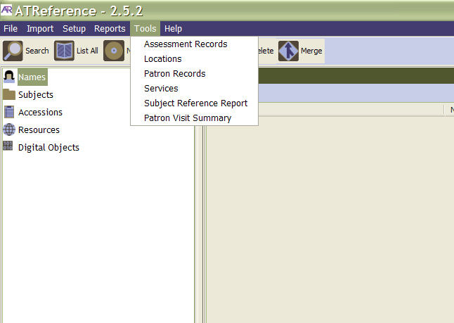

Slide 13
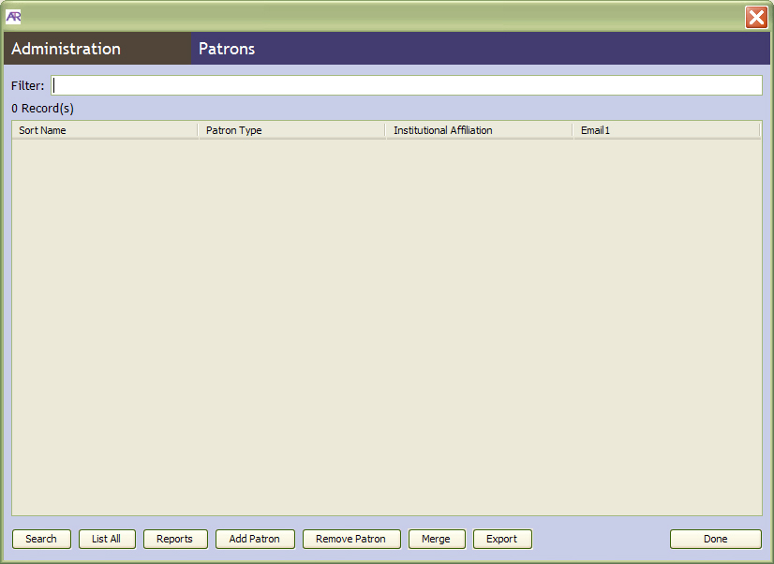

Slide 14
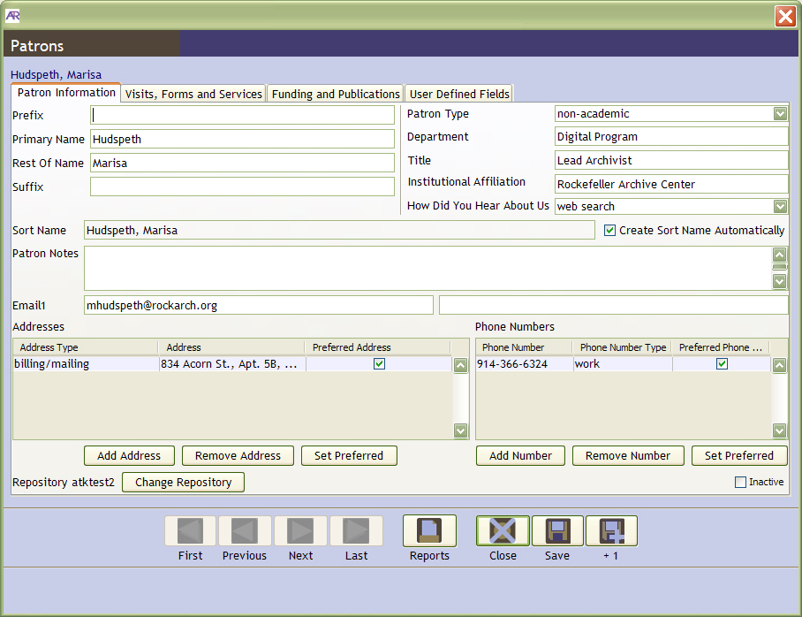

Slide 15
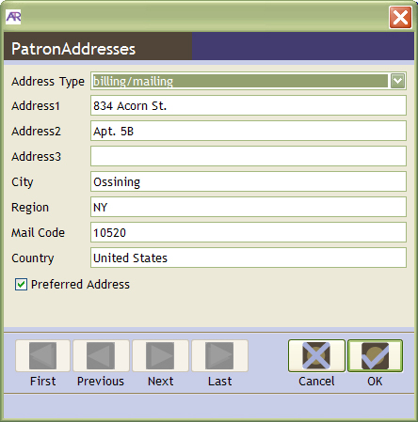

Slide 16
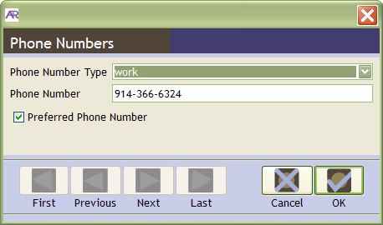

Slide 17
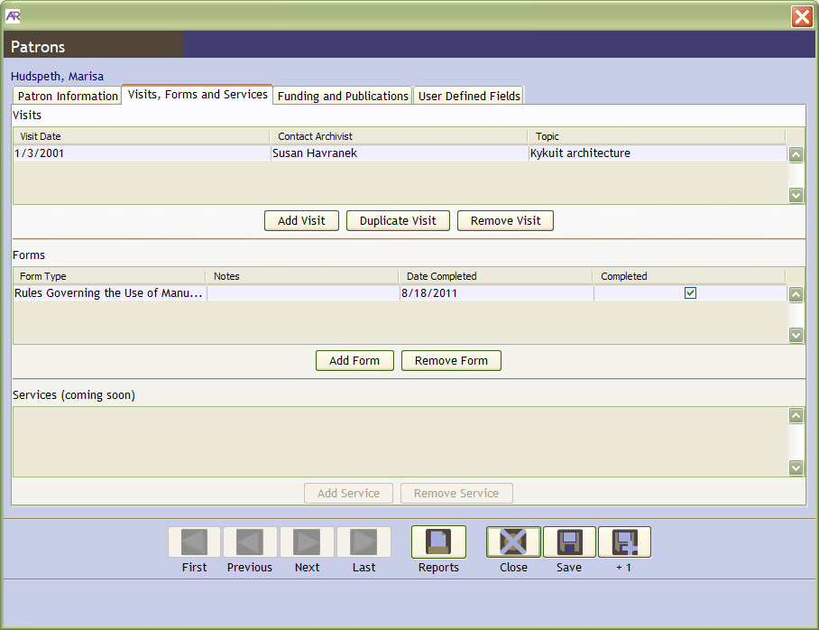

Slide 18
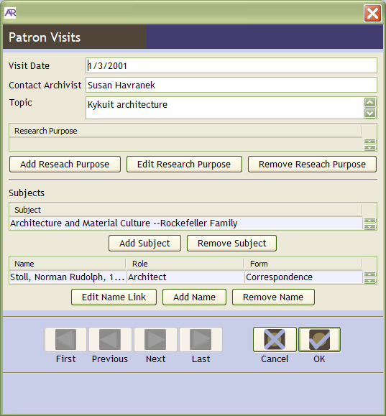

Slide 19
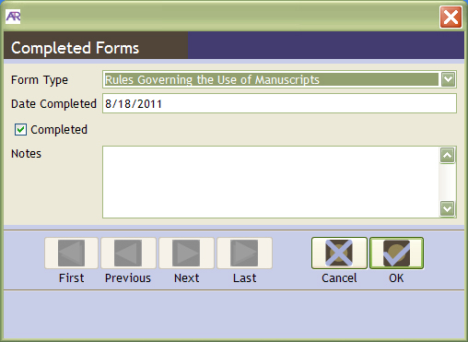

Slide 20
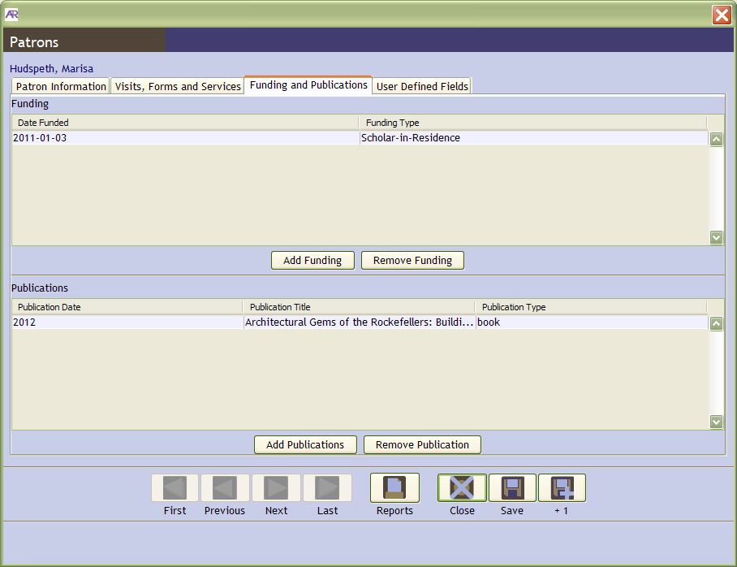

Slide 21
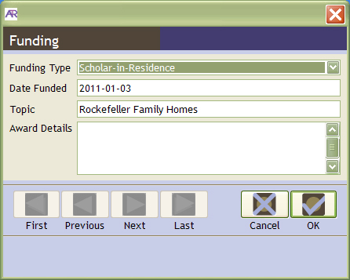

Slide 22
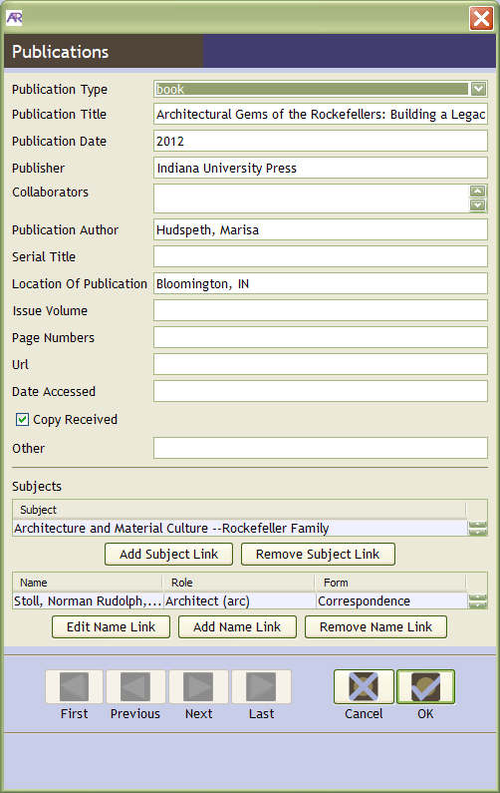

Slide 23
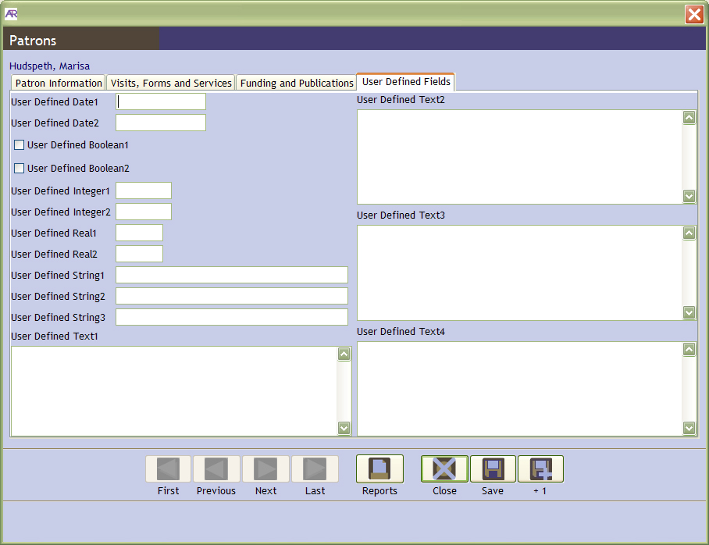

Slide 24
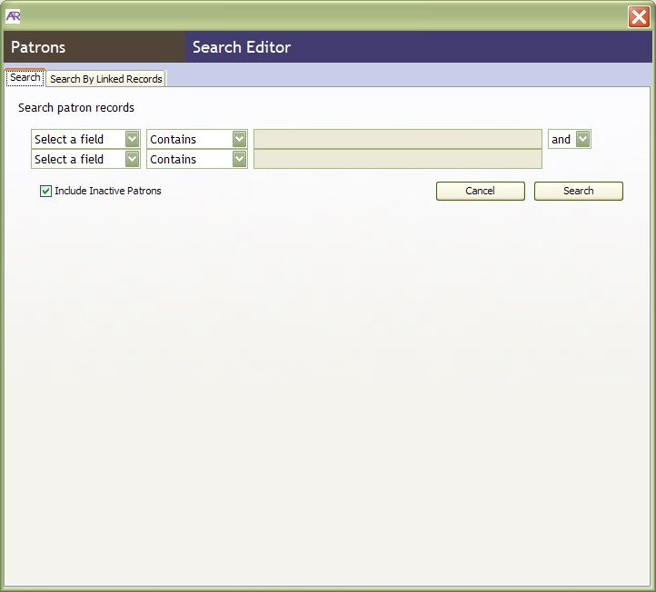

Slide 25
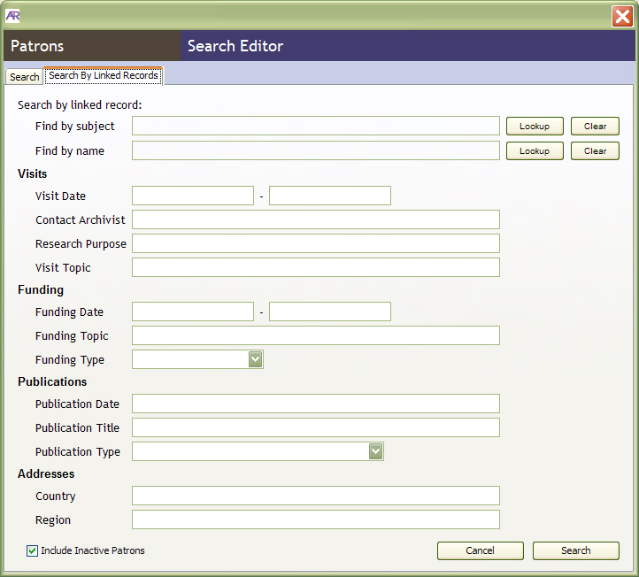

Slide 26
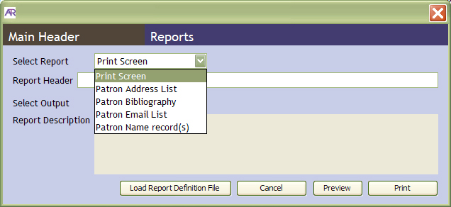

Slide 27
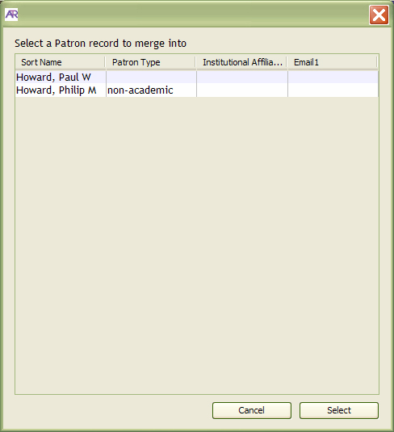

Slide 28
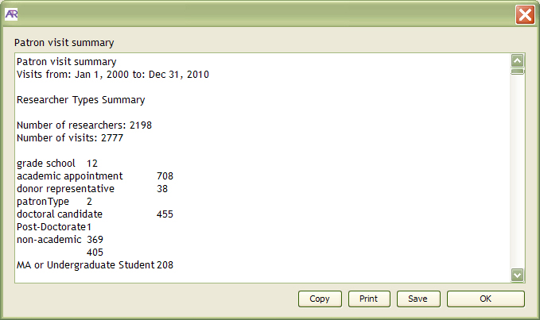

Slide 29
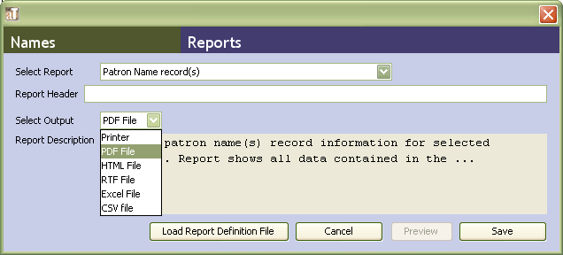

Slide 30
For more information, Please visit our Github site:
https://github.com/RockefellerArchiveCenter/ATReference/wiki
Send questions and comments to:
mhudspeth@rockarch.org

